Slide 1
PROJETO COO_TEX
Estudos Arquitetura

Slide 2
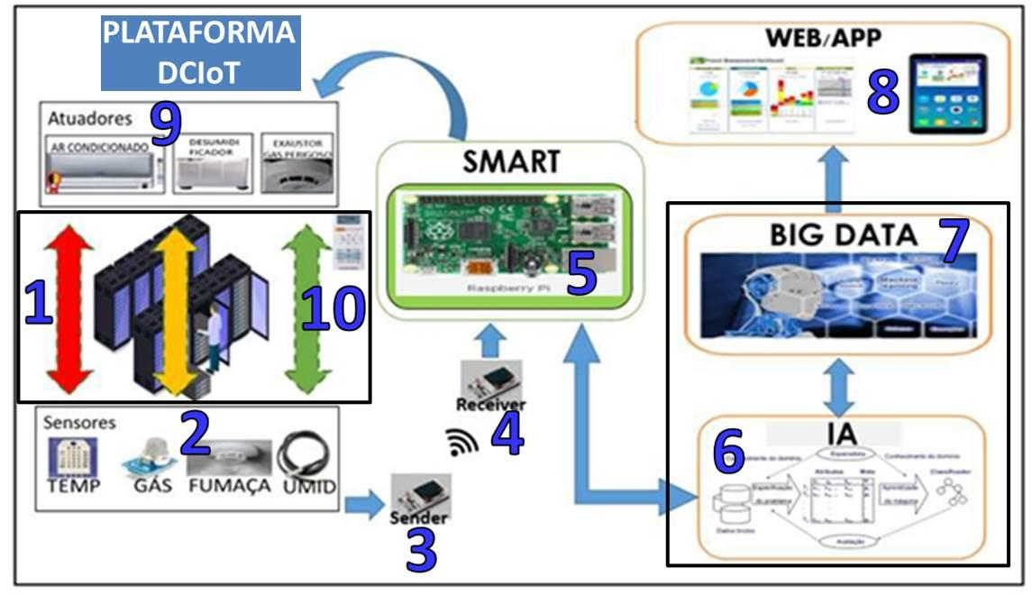
Figura 9 - Visão geral do Sistema DCIoT.

Slide 3
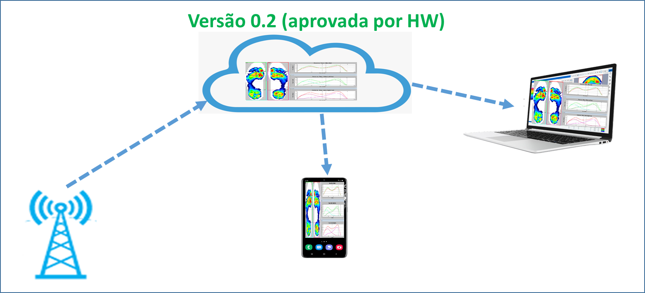
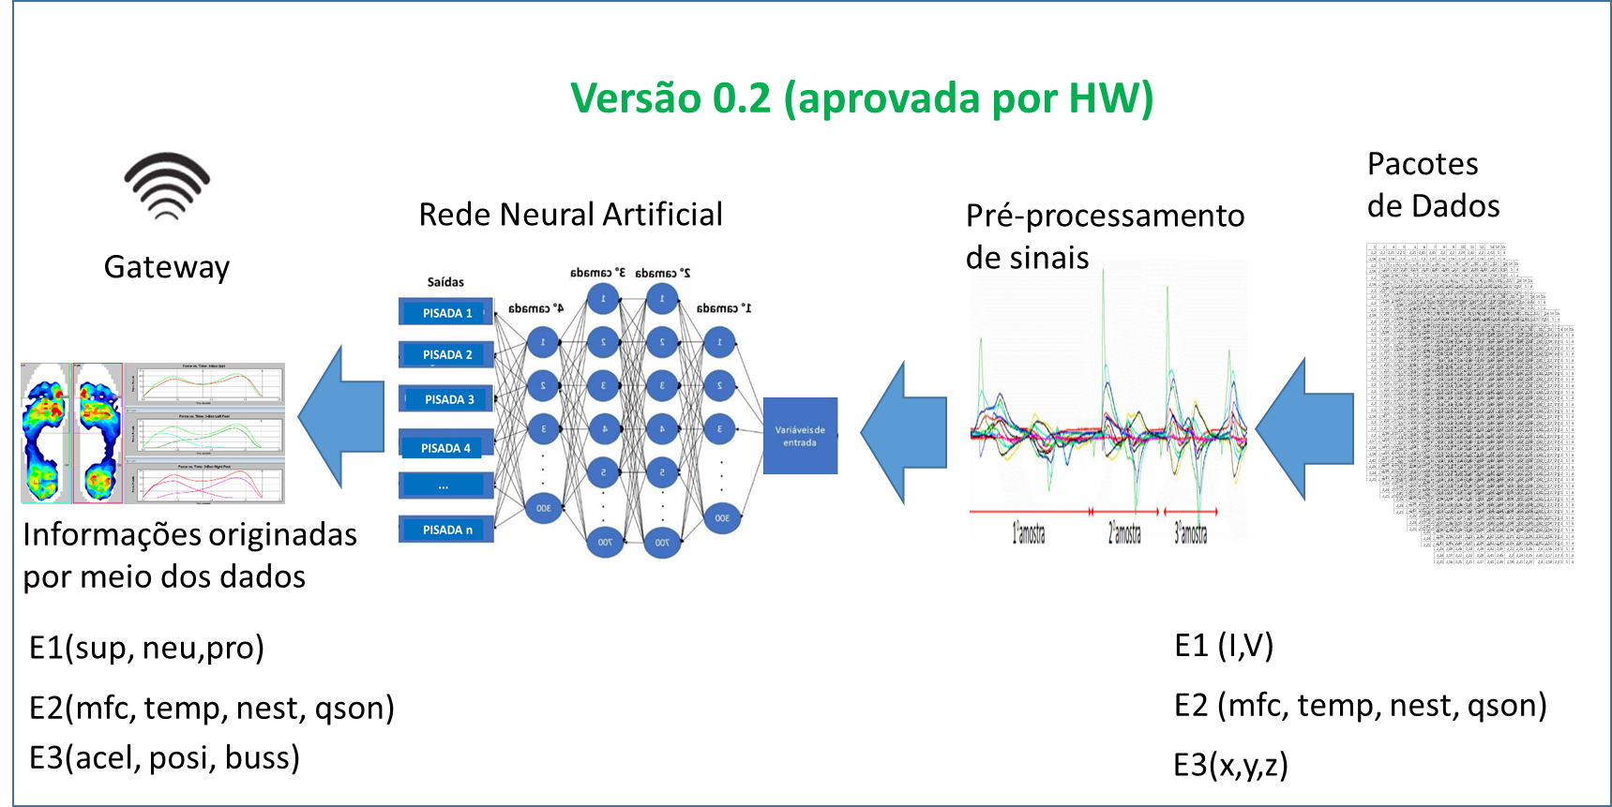
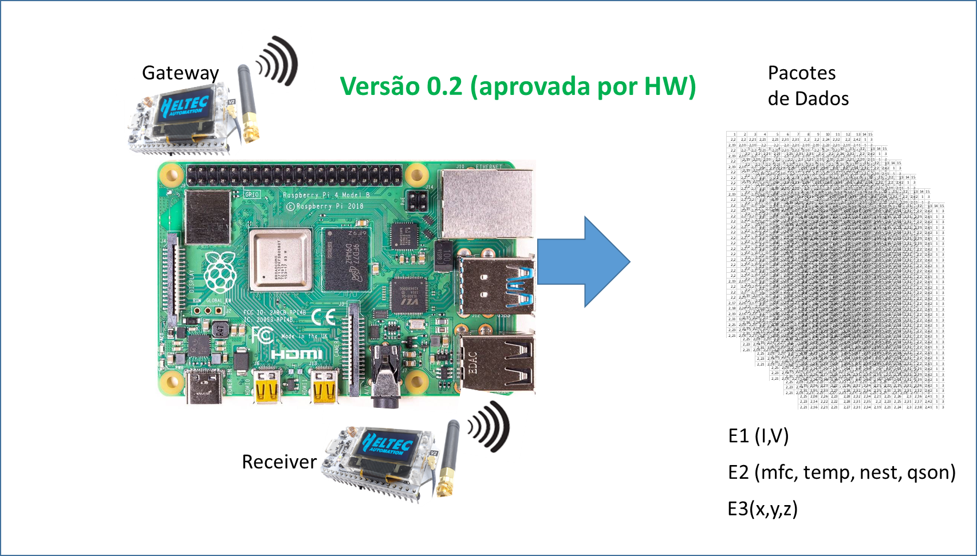
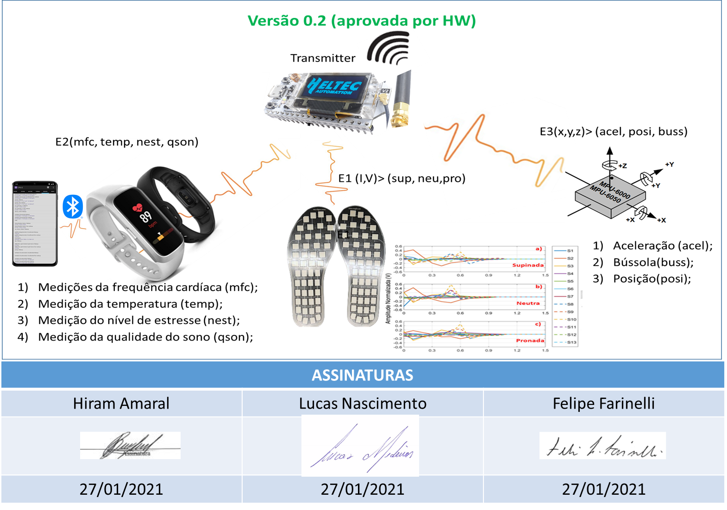

Slide 4
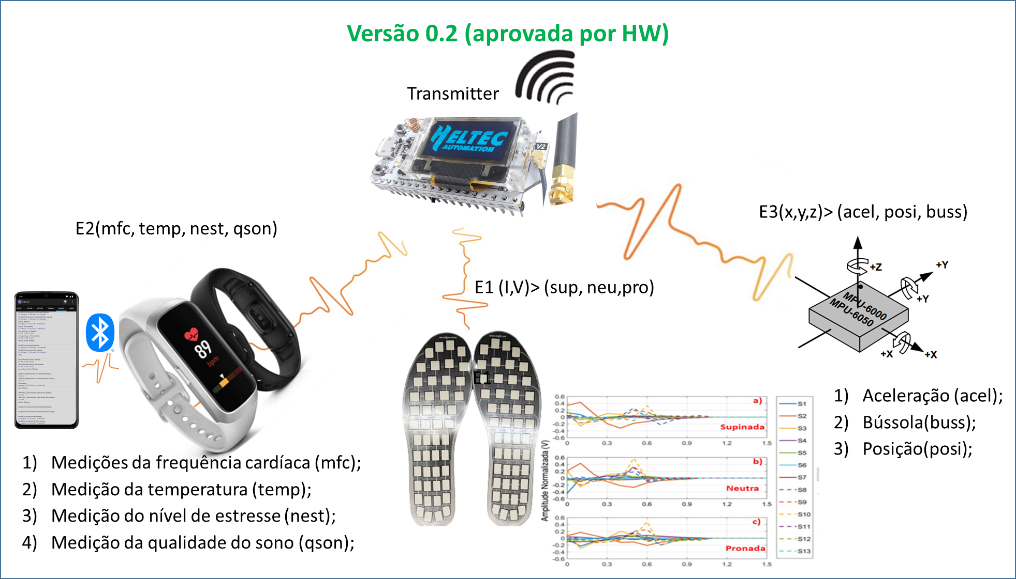
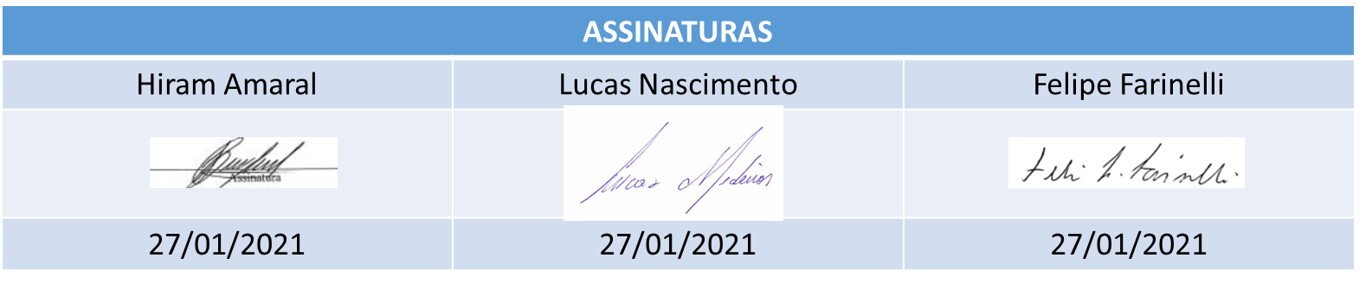

Slide 7
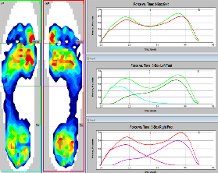

Slide 8
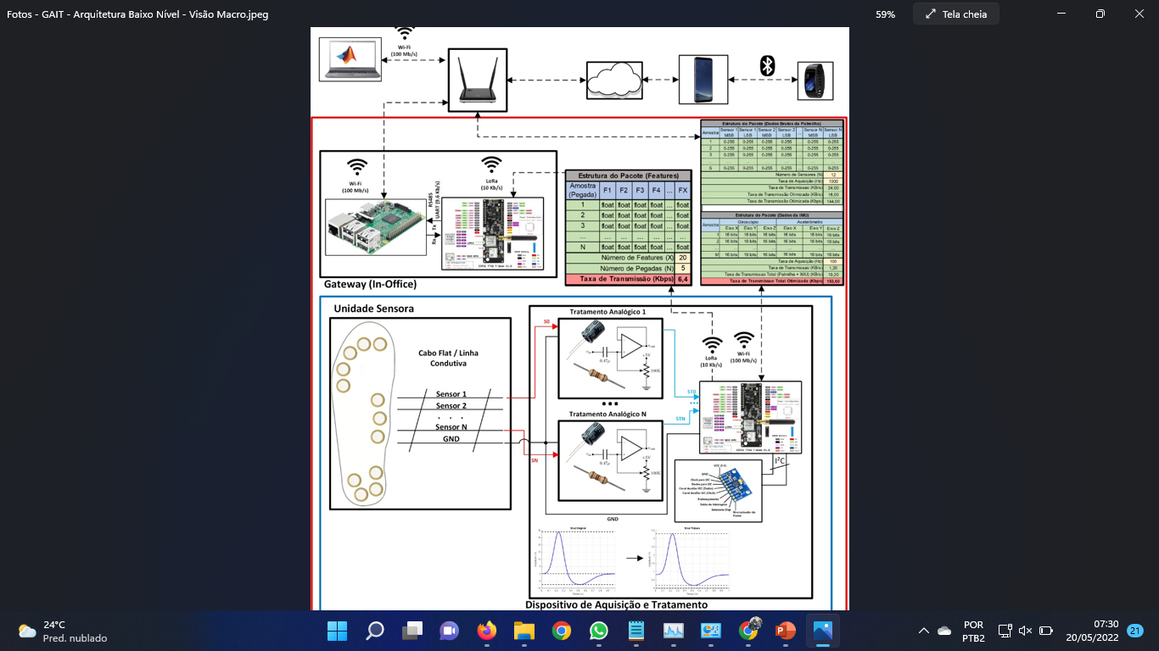

Slide 9
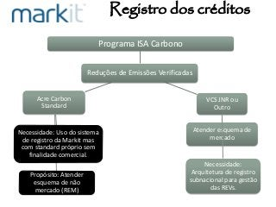

Slide 10
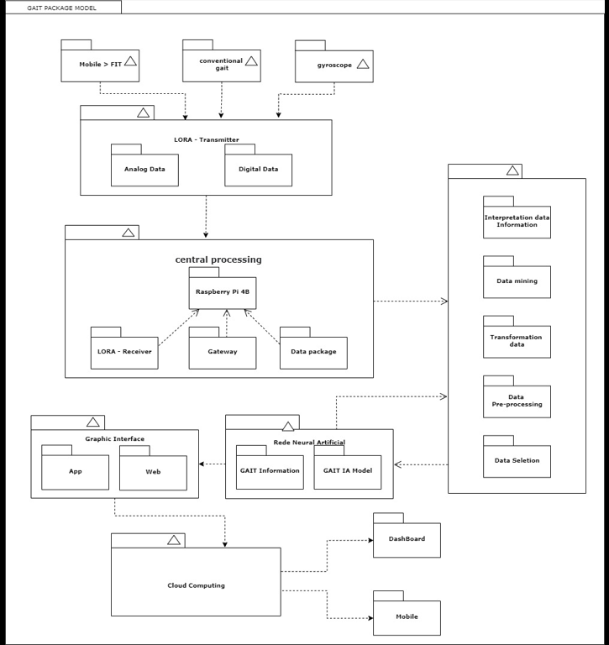

Slide 11
https://www.gov.br/mma/pt-br
http://imc.ac.gov.br/isa-carbono/

Slide 12
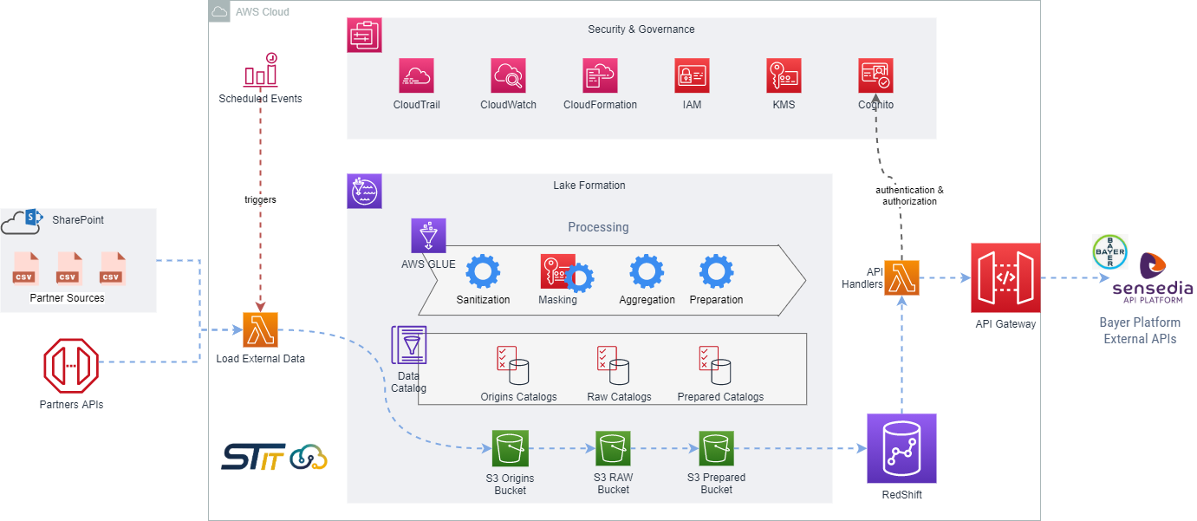
https://aws.amazon.com/pt/solutions/case-studies/bayer/

Slide 13
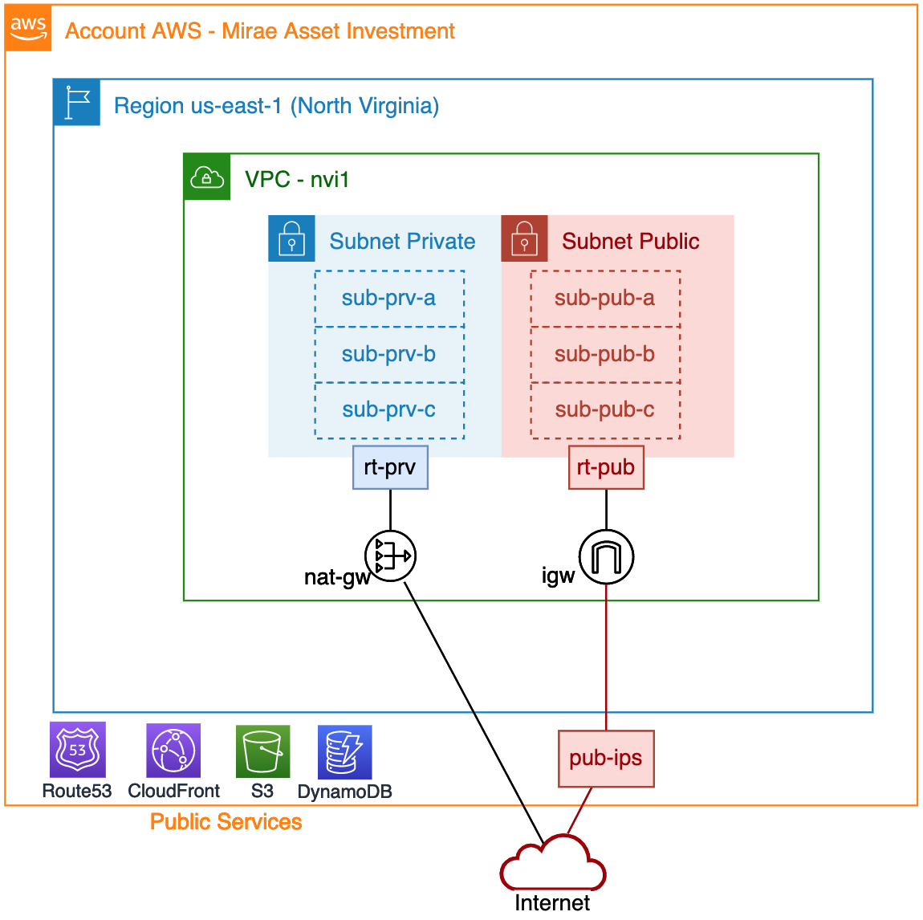

Slide 14
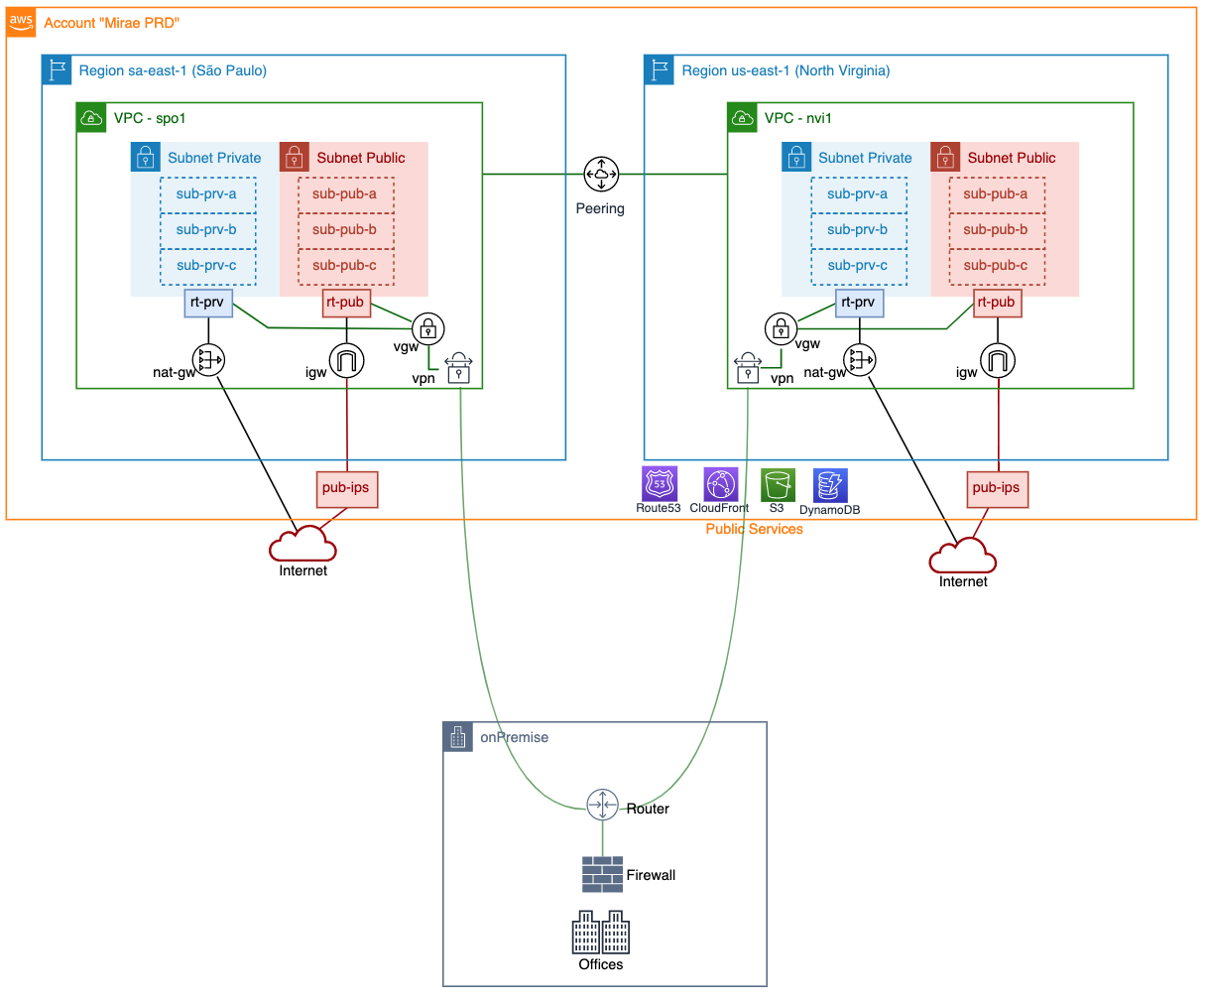

Slide 15
https://www.cybermedian.com/aws-architecture-diagram-with-2019-new-icons-over-50-examples/

Slide 16
https://aws.amazon.com/pt/blogs/aws-brasil/arquitetura-de-data-mesh-com-aws-lake-formation-e-aws-glue/

Slide 17
